Slide 1


Slide 2
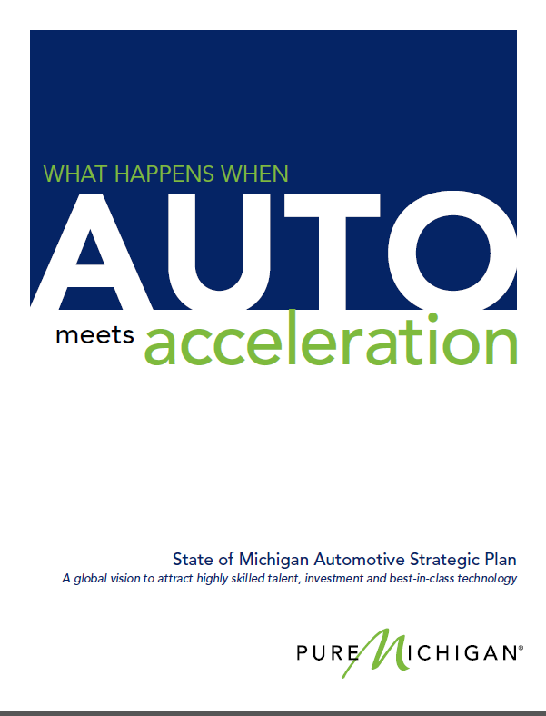
Michigan Automotive Office
Vision
“We will leverage the strengths and assets of Michigan’s automotive industry for sustained intellectual and manufacturing global leadership. Our vision is that every significant entity in the global automotive industry has a strong presence in the State of Michigan”
Mission
A Mandate from Michigan’s Governor
“To implement and execute a comprehensive strategic plan to drive Michigan’s automotive industry forward to remain as the global center of the automotive industry and to foster sustainable growth within the industry in Michigan”
Notes:
Established September 2013 by Governor Snyder

Slide 3
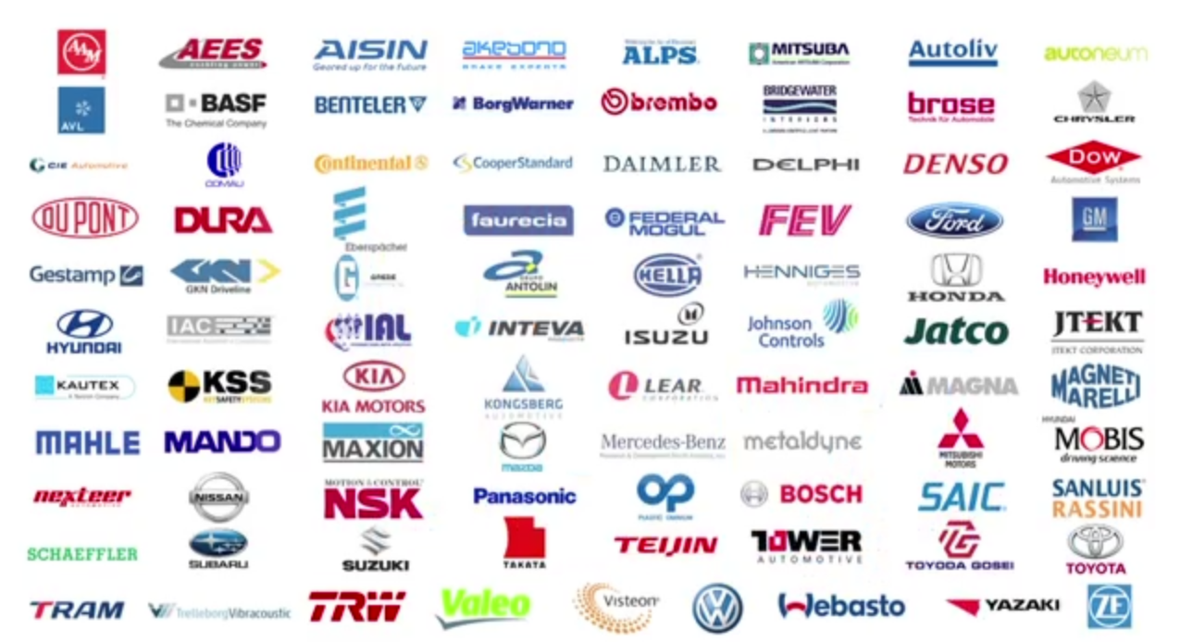
OEMs and suppliers with operations in Michigan
Notes:
Michigan’s industry partners: OEMs and suppliers with operations in Michigan

Slide 4
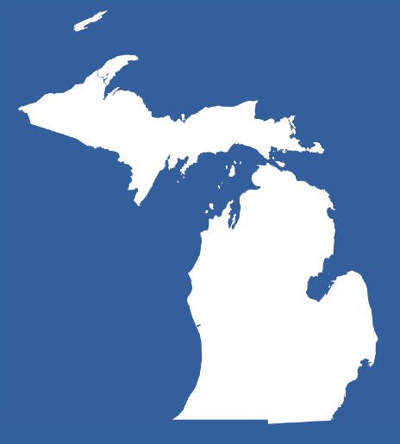
Automotive Industry Employment by Top 10 States,
October 2014
Source: Current Employment Statistics, Bureau of Labor Statistics
*Transportation Equipment Manufacturing Employment
Notes:
States with asterisk do not have automotive industry employment breaking out from transportation equipment manufacturing. Therefore these state employment includes aircrafts, boats, and other transportation equipment manufacturing employment.
SMU26000003133610001
SMU26000003133630001
SMU18000003133610001
SMU18000003133630001
SMU39000003133610001
SMU39000003133630001
SMU21000003133610001
SMU21000003133630001
SMU01000003133610001
SMU01000003133630001
SMU17000003133600001
SMU47000003133600001
SMU29000003133600001
SMU48000003133600001
SMU45000003133600001
SMU13000003133600001
SMU37000003133600001
SMU42000003133600001
SMU28000003133600001
Last Updated: 11/25/14

Slide 5
Number of Tool & Die Facilities By Top 10 States, 2013
Michigan’s 640 represents 19% of U.S. total
Source: BLS
Notes:
U.S. Total = 3409

Slide 6
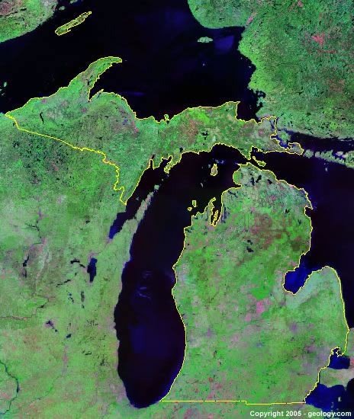
Number of Metalworking Machining Manuf. Facilities
By Top 10 States, 2013
Source: BLS
Notes:
Michigan = 1414 total

Slide 7
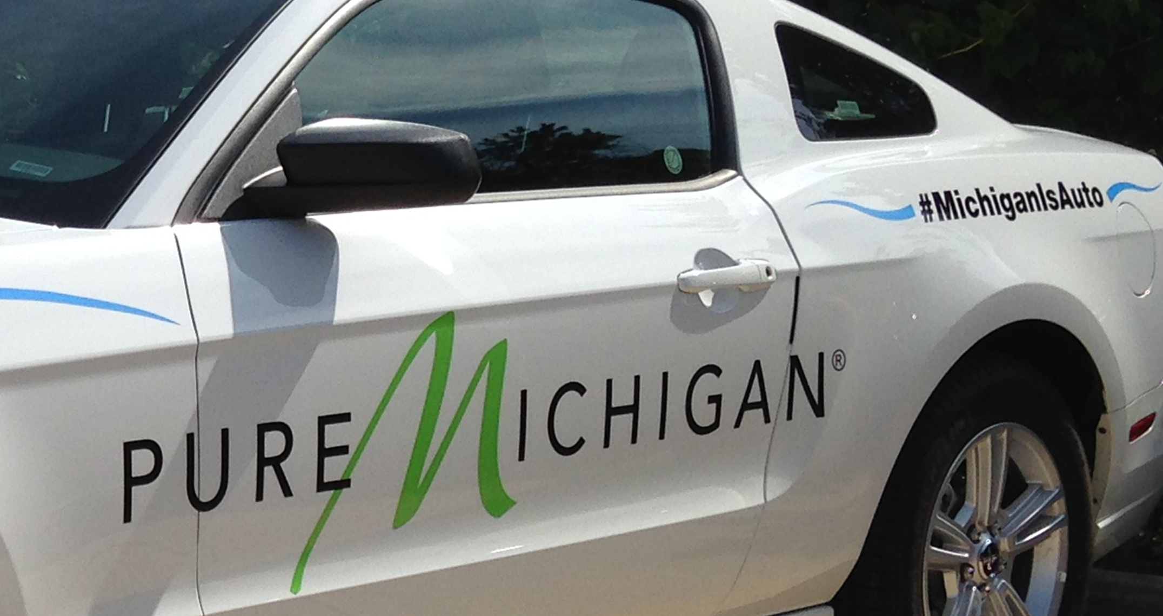
Number of Automotive Manufacturing Facilities
By Top 10 States, 2013
Source: BLS
Notes:
Michigan = 890

Slide 8
U.S. Top 10 States for Automotive R&D Spending, 2011
Source: Business R&D and Innovation Survey, National Science Foundation. 2011 is the latest data available.

Slide 9
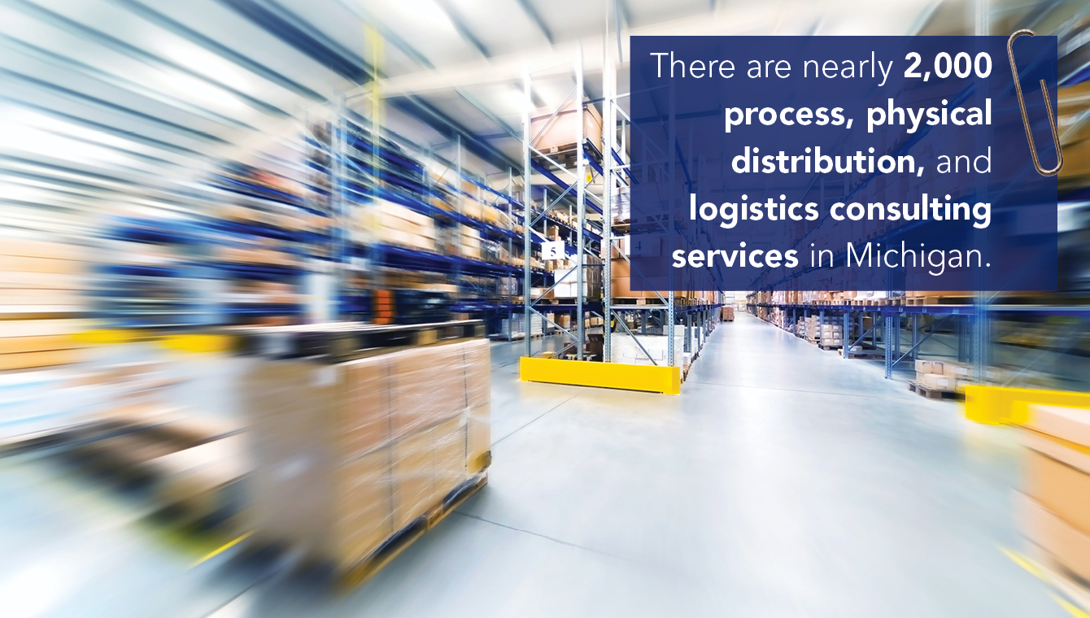

Slide 10
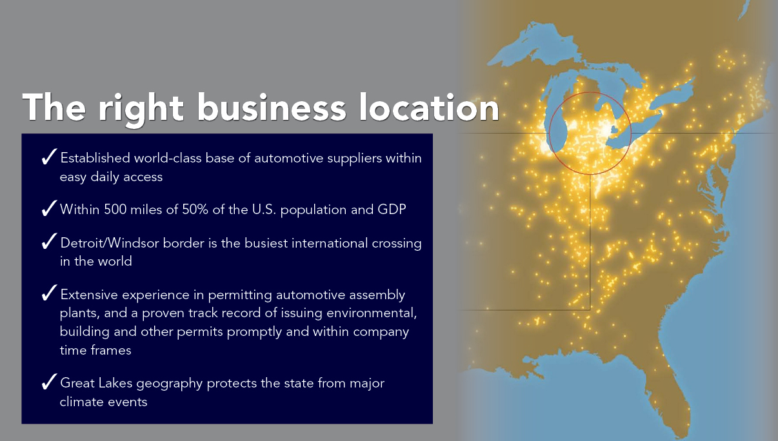

Slide 11
Automotive Strategic Plan Summary
State of Michigan
Automotive Office
Technology “Globally Best in Class”
Connected and automated vehicles Advanced light-weighting and multi-material vehicles Advanced powertrain and propulsion systems Advanced manufacturing Integrated and connected supply chain R&D, advanced engineering and pilot plant
Talent “Attract and Retain the World-Class Talent”
Engineering and design Software and coding Systems integration Skilled trades including re-training Creation of “master technicians” Technology management excellence Manufacturing management excellence
Capital “The Right Capital at the Right Time”
Federal funds State funds Government owned/contractor operated Industry investment Public-private partnerships Venture capital and private equity Foreign direct investment
State of Michigan Strategic Plan
Automotive Industry Stakeholders

Slide 12

Notes:
And last, but not least, the quality of life in Michigan. Our state is shaped and surrounded by the Great Lakes. Last year, GMA named Michigan’s sleeping bear dunes the most beautiful place in America. We offer a lifestyle that includes everything from urban excitement to a number of outdoor sports such as golf, watersport, skiing, and hiking. We are surrounded by 4 of the five Great Lakes, have more than 11,000 inland lakes, more public golf courses than any other state and about 77,000 km2 of forest. And all of that is Pure Michigan!
Great Lakes geography protects Michigan from major weather problems:
Since 2009, states directly south of Michigan have experienced twice as many billion dollar weather and climate disasters
states such as Tennessee and North Carolina have experienced three to four times more billion dollar weather events

